Slide 1
BEE-SAFE DRIVING SCHOOL
OWNERS / INSTRUCTORS – ASST. Chief of Police Mike Strait and SGT. Sam Williams (Brookville Police Department)
Mike and Sam have a combined 18 years of emergency vehicle operation training, experience with Indiana’s traffic laws, and have been certified Indiana driving instructors since 2022
INSTRUCTOR – Taylor Erfman – Bachelor’s of Science in Biology-Chemistry, teaches math and science at Connersville High School, and a certified Indiana driving instructor since 2024
INSTRUCTOR – Tony Strait – Retired automotive maintenance/repair, and certified Indiana driving instructor since 2023

Slide 2
CDE FORM/ OBTAINING PERMIT
ONCE YOU HAVE REGISTERED YOUR ONLINE ACCOUNT, MADE PAYMENT, AND SUBMITTED YOUR CONTRACT A CDE FORM WILL BE UPLOADED TO YOUR ONLINE CLASSROOM ACCOUNT.
TO OBTAIN YOUR PERMIT AT THE BMV YOU WILL NEED THE FOLLOWING: CDE FORM, ORIGINAL BIRTH CERTIFICATE, SOCIAL SECURITY CARD, 2 PROOFS OF RESIDENCY, AND A PARENT / LEGAL GUARDIAN.
FOR YOUR PROOFS OF RESIDENCY, YOU CAN USE THE FOLLOWING: REPORT CARDS, SCHOOL TRANSCRIPTS, AND BANK STATEMENTS.

Slide 3
BMV PERMIT TEST
MAKE SURE YOU ARE THERE 1 HOUR BEFORE THE BMV CLOSES. THEY SCHEDULE THE TEST FOR 1 HOUR.
USE THE BMV MANUAL AS A STUDY GUIDE.
YOUR CHOICE OF A PAPER/PENCIL TEST OR COMPUTER TEST.
16 SIGNS IF YOU MISS 2 YOU FAIL, 34 REGULAR MULTIPLE CHOICE QUESTIONS MISS 6 YOU FAIL.
IF YOU FAIL YOU MUST WAIT 1 DAY TO TEST AGAIN.

Slide 4
PERMIT PRACTICE TEST WEBSITE
WWW.DRIVING-TESTS.ORG
200 PRACTICE QUESTIONS. HIGHLY RECCOMMENDED FOR STUDENTS TO KNOW WHAT TO EXPECT.

Slide 5
ONCE YOU PASS THE PERMIT TEST
YOU WILL RECEIVE A PAPER PERMIT FIRST. THE PLASTIC PERMIT TYPICALLY ARRIVES IN THE MAIL WITHTIN 1 WEEK.
STUDENTS CAN BEGIN DRIVING ONCE THEY OBTAIN THEIR PERMIT. MUST HAVE A PARENT OR RELATIVE AT LEAST 25 YEARS OLD WITH A VALID DRIVERS LICENSE IN THE FRONT PASSENGER SEAT.
YOU DO NOT NEED YOUR PERMIT TO START ONLINE CLASS.
STUDENTS ARE COVERED UNDER PARENTS INSURANCE POLICY WHILE ON THEIR LEARNER’S PERMIT. STUDENTS MUST BE ADDED TO POLICY WHEN THEY OBTAIN THEIR LICENSE.

Slide 6
WHEN YOUR STUDENT OBTAINS PERMIT
TEXT MIKE STRAIT 765-580-2456 OR SAM WILLIAMS 513-490-4118
PROVIDE YOUR STUDENT’S NAME AND THAT THEY PASSED, SO WE CAN ADD THEM TO OUR DRIVING SCHEDULE.

Slide 7
PARENT INFO DOWNLOADS
NO CELL PHONE USE WHILE DRIVING, INDIANA IS A HANDS-FREE DRIVING STATE.
WHEN STUDENTS OBTAIN THEIR LICENSE, THEY ARE ON A 6 MONTH PROBATIONARY PERIOD.
NO PASSENGERS EXCEPT FOR SIBLINGS.
50 HOUR DRIVING LOG- YOU MUST OBTAIN 50 HOURS OF DOCUMENTED DRIVING BEFORE RECEIVING YOUR LICENSE. 10 HOURS MUST BE AT NIGHT. YOU CAN INCLUDE THE 6 HOURS DRIVEN IN DRIVER’S EDUCATION.
DRIVING LOG WILL BE TURNED INTO THE BMV WHEN STUDENTS GO TO OBTAIN THEIR LICENSE.

Slide 8
CLASS CURRICULUM
STUDENT MUST GET 80% OR HIGHER TO PASS IN THE ONLINE CLASSROOM AND BEHIND THE WHEEL INSTRUCTION, THIS IS A STATE REQUIREMENT.
STUDENTS MUST COMPLETE THE ONLINE CLASSROOM PRIOR TO THEIR 6 HOURS OF BEHIND THE WHEEL INSTRUCTION.
THE BEHIND THE WHEEL INSTRUCTION OF OUR DRIVING EDUCATION PROGRAM WILL INVOLVE: TOWN DRIVING, RURAL ROADS, STATE HIGHWAY, PARKING, AND INTERSTATE DRIVING.
UPON COMPLETION OF THE BEHIND THE WHEEL INSTRUCTION STUDENTS WILL RECEIVE A COMPLETION FORM. THE COMPLETION FORM WILL BE TURNED INTO THE BMV WITH THE 50-HOUR DRIVING LOG AND ONLINE COMPLETION CERTIFICATE WHEN THEY GO TO OBTAIN THEIR LICENSE.

Slide 9
IN-CAR DRIVING
1 STUDENT AT A TIME.
DRIVING TIMES ARE AVAILABLE FROM 8:00 A.M. TO 8:00 P.M. DEPENDING ON INSTRUCTOR AVAILABILITY. (WHEN SCHOOL IS IN SESSION : AFTER SCHOOL AND WEEKENDS).
ATHLETES WILL DRIVE AFTER PRACTICE, ON WEEKENDS, OR AFTER THE SEASON IS COMPLETE.
IF YOU DRIVE AFTER SCHOOL, WE WILL PICK YOU UP AT THE SCHOOL YOU ATTEND. DRIVE TIME IS 2 HOURS PER SESSION AND STUDENTS CAN BE DROPPED OFF AT THE SCHOOL THEY ATTEND, THE BEE-SAFE LOCATION IN YOUR AREA, OR A MUTUALLY AGREED UPON LOCATION.
WE WILL TRY TO DRIVE 3 DAYS STRAIGHT IF POSSIBLE.

Slide 10
WAIVER TESTING
WE PROVIDE A WAIVER TEST SO YOUR STUDENT DOES NOT HAVE TO TEST THROUGH THE BMV.
STUDENTS CAN WAIVER TEST THROUGH US AFTER THEY COMPLETE THE ONLINE CLASS AND THEIR 6 HOURS OF DRIVING INSTRUCTION.
THE BMV TEST IS FREE, WAIVER TESTING THROUGH US COST $40
IF THEY WAIVER TEST THROUGH US THEY USE OUR VEHICLES AND INSTRUCTORS.
THE DAY OF WAIVER TESTING THEY WILL NEED TO BRING THEIR COMPLETION CERTIFICATE AND WAIVER FEE.

Slide 11
WAIVER TESTING SIGN UP
BEE-SAFEDRIVINGSCHOOL.COM
CLICK ON WAIVER TEST IN OUR WEBSITE MENU. SELECT THE LOCATION YOU WOULD LIKE TO ATTEND (BROOKVILLE, LIBERTY, OR CONNERSVILLE)
ADD YOUR STUDENT’S NAME TO THE NEXT AVAILABLE TIME SLOT.

Slide 12
PAYMENT
TOTAL COST OF BEE-SAFE DRIVING SCHOOL: $460.00
$230.00 DOWN PAYMENT DUE AT REGISTRATION.
$230 BALANCE DUE AT 75% COMPLETION OF THE ONLINE CLASSROOM.

Slide 13
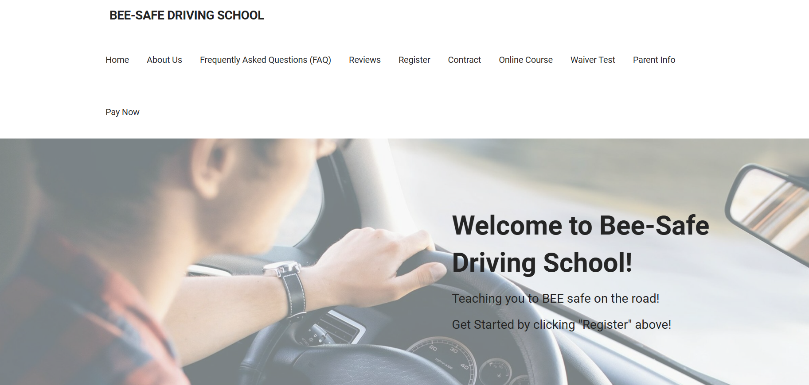



The 3 Steps To Complete Your Registration Can Be Found In Our Main Menu

Slide 14
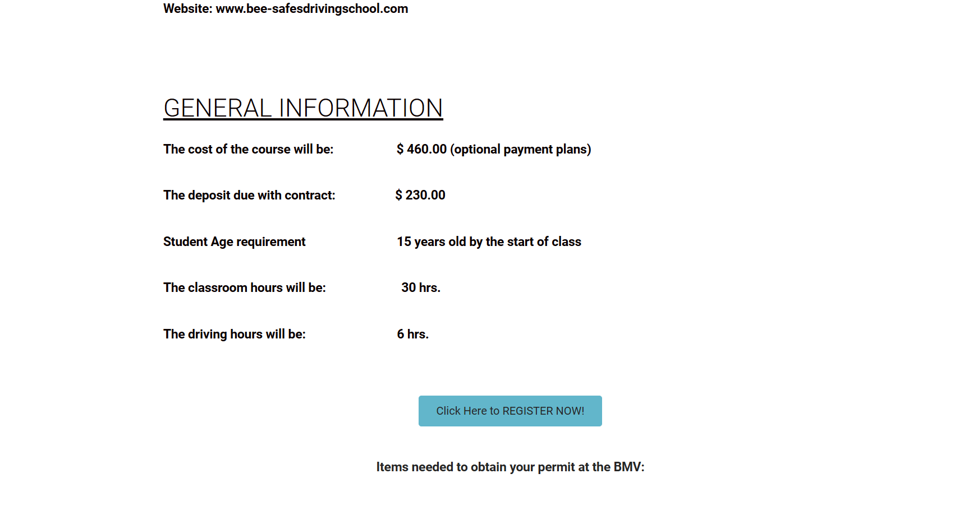
STEP 1 : After clicking the REGISTRATION tab you can complete your classroom registration by clicking the blue link.

Slide 15
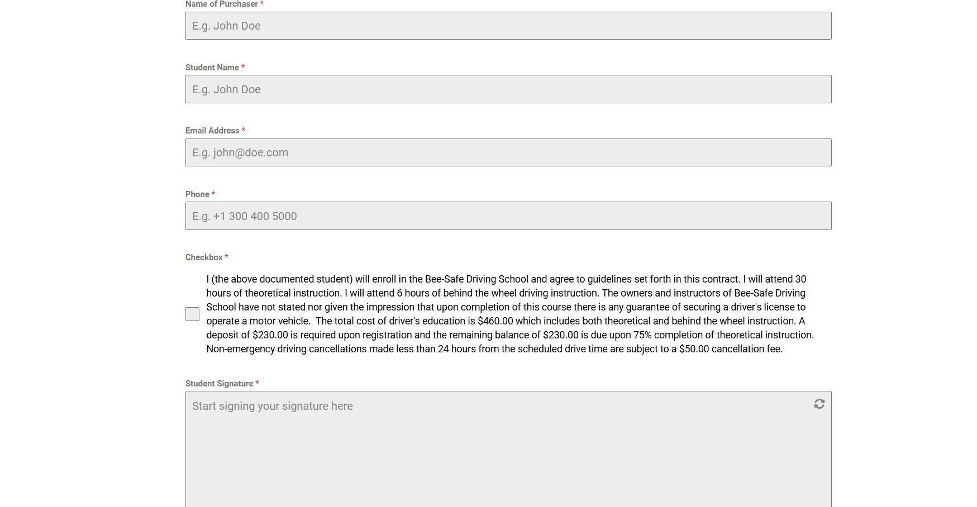
STEP 2: After clicking the CONTRACT tab you will complete and submit the contract.

Slide 16
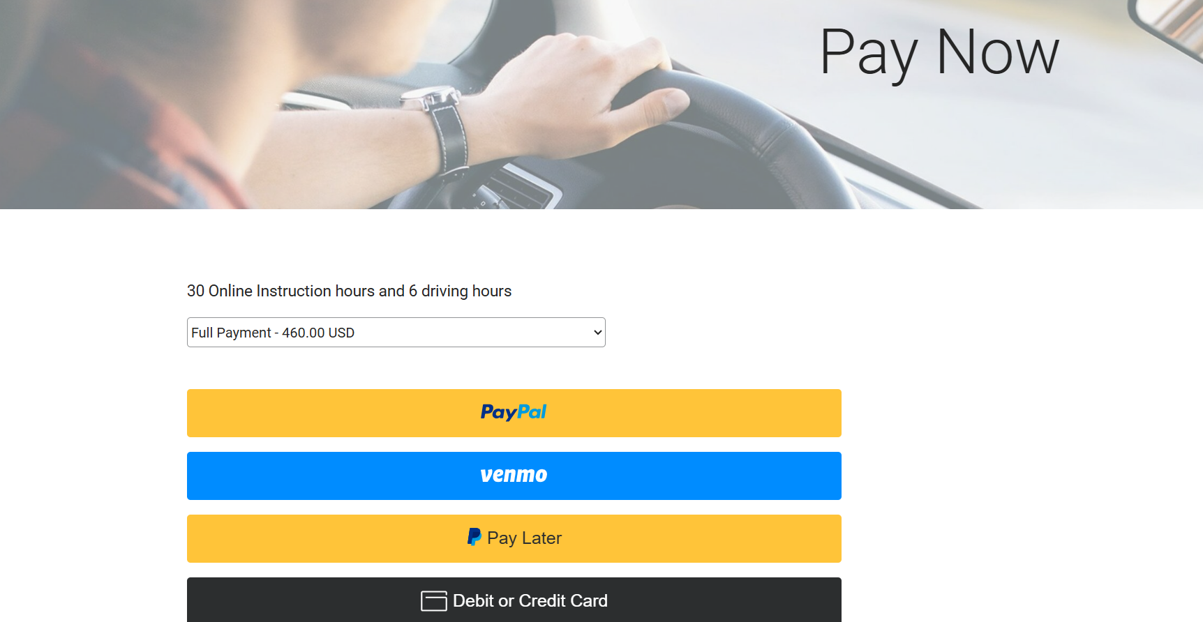
STEP 3: After clicking the PAY NOW tab make your payment. You can select full payment or deposit.

Slide 17
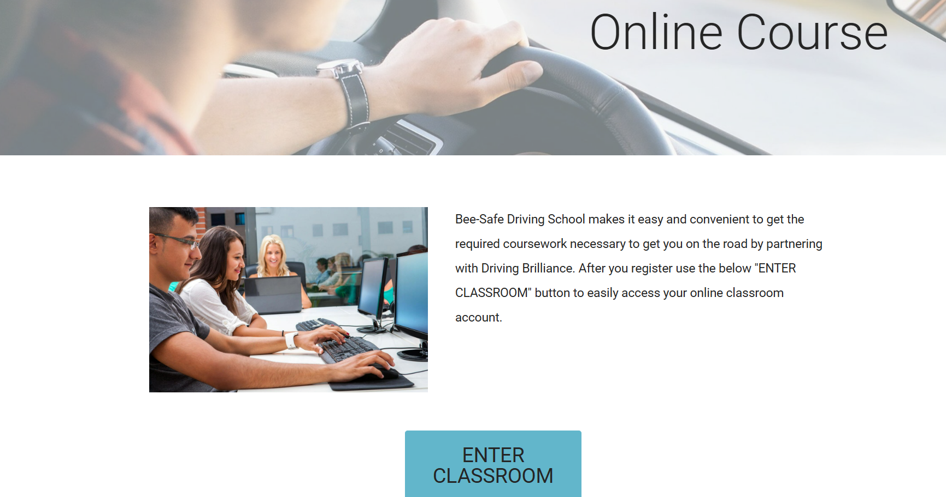
Your student can return to their online classroom by clicking the ONLINE COURSE tab and the blue link to enter classroom.

